Slide 1
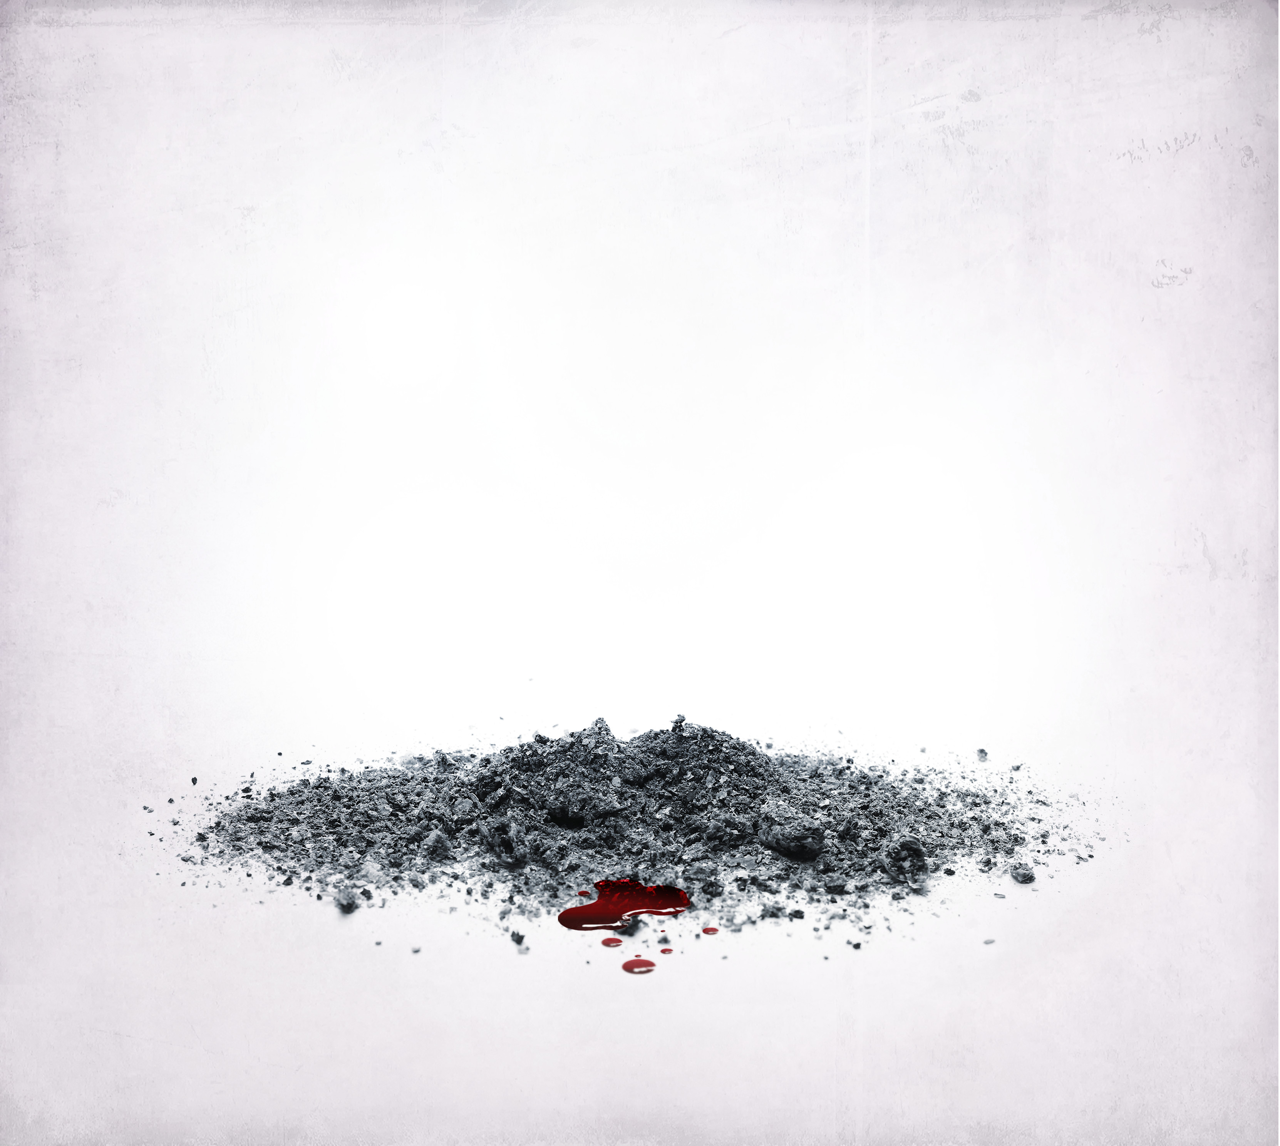

RED SEA
RED SEA
WEBSITE CONTENT MANAGER
WEBSITE CONTENT MANAGER

Slide 2


Overview
A website content manager enabling website owners to easily update featured content.
Aimed at those who do not require regular review and changes to the overall design of their website, however, frequently produce new products and content.
Featured content can be easily managed without maintenance downtime. New releases can be planned with scheduling. Images can be associated with content for that additional front-end wow factor.

Slide 3
Motivation
To move my band’s website dependency away from external providers. Simultaneously reducing band running costs and increasing band management efficiency.

Slide 4
User Story
As a musician in an independently operated band I want to:
Easily and efficiently update website content such as, Music, Videos, Media & more!
Schedule new content to prepare upcoming music and video releases

Slide 5




Technologies
MongoDB – Atlas https://www.mongodb.com/cloud/atlas
Express https://expressjs.com/
React https://reactjs.org/
Node.js https://nodejs.org/en/

Slide 6
Node Packages (root)
Dev Dependencies
concurrently ^5.2.0
nodemon ^2.0.4
Dependencies
axios ^0.19.2
express ^4.17.1
mongoose ^5.9.25
multer ^1.4.2
if-env ^1.0.4

Slide 7
Node Packages (client)
Dependencies
axios ^0.19.2
react ^16.13.1
react-dom ^16.13.1
react-router-dom ^5.2.0
react-scripts ^3.4.1

Slide 8
Challenges & Successes
Challenges
Designing with zero dependencies on CSS3/ JavaScript libraries or frameworks
A persistent error in my local environment that restricted the ability to test connections to the server. This meant the only way I could test was to deploy to Heroku. It’s a development nightmare and something I’ll need to address to further expand on this project.
Successes
Honing my skills with CSS3 to produce visually stunning website and UI
Utilising MongoDB Atlas in place of Heroku’s mLabs add-on

Slide 9

DEMO

Slide 10
Future Development
Front-end
Embed tour dates utilising our existing BandsInTown account
Add Media, Video, Tours, and Shop/ Merch pages
Back-end
Add login requirement to access admin area
Expand on existing features to allow Media and Video content to be managed

Slide 11
Links
GitHub repo
https://github.com/Solmarnov/redseaband
Deployed website
https://red-sea-band.herokuapp.com/
Expand on existing features to allow Media and Video content to be managed

Slide 12
THANK YOU!
THANK YOU!

